Slide 1
Moving Toward a Person Centered Culture: An Educational Approach
Lois Thornton RN BN MEd
May 29, 2015
CGNA Conference, Charlottetown, PEI

Slide 2
Defining Person and Person centered Nursing
Person:
has intrinsic value
Implies recognition, respect, trust
In relationship, in social world, in place and time, with self
Person centered nursing:
Human experience is at the center of care delivery
Relationship focused, collaborative, holistic
Notes:
These ideas are widely accepted as essential to quality nursing care and are espoused in vision and mission statements, but making them operational in practice is challenging.

Slide 3
Why a person-centered culture?
Replacing “person centered moments” with “a way of doing business”
Living the vision requires normalization of person centered thinking and practices
Notes:
In a person centered culture, person centeredness applies to all stakeholders, residents, families, caregivers, etc. Caregivers are given the same consideration in autonomy, trust, respect. Consideration is given to relationship and the human experience of the caregivers as well.
Licensing requirements and evaluation or accreditation are focused on metrics—what can be measured eg. Facility acquired infection, medication error, incident reports—the do not consider resident and family experience. Yet when people are asked what constitutes good care to them—excluding competence of caregivers which is considered as a given—they relate how their preferences and personal needs were met, the relationship aspects of care, how they were made to feel.

Slide 4
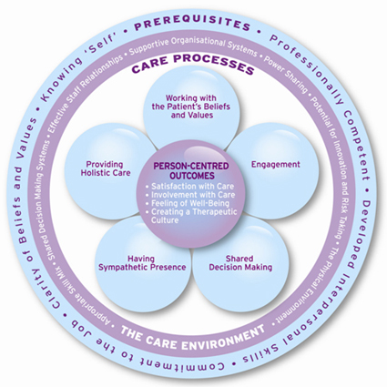
The Model
McCormack & McCance, 2010)
Notes:
The model includes not only what we do but who we are as nurses—our values, competencies, self understanding, commitment—the environment that we work in, and the processes that we use, to bring about person centered outcomes. All of these things combine to make the workplace culture, and contribute to the extent to which our care is person centered.
Specifies outcomes that can be observed and measured.

Slide 5
The workshops
Promoting an Awareness and Understanding of Person Centeredness
Developing a Shared Vision
Determining the Quality of User Experience
Planning for Practice Change
Notes:
Description of the objectives of each workshop
Do Victorian Parlour Game—Read poem at the end of the workshop
Describe how they made out—what difference did the workshops make?

Slide 6
Keys to success
Shared vision; understanding and discussion of ethical implications
Articulating shared values: knowing self and understanding personal and professional values
Identifying facilitators of practice change
Encouraging practice development at staff level: supportive systems, power sharing, potential for innovation and acceptance of risk taking, team building, learning culture
Adapting the care environment
Notes:
Balancing resident preference and decision making with professional obligation and organizational requirements
Personal and professional values clarification combined with nurturing and articulation of a shared vision. Evaluation of the operationalization of the vision within care processes and the environment.
Champions for person centered processes and practices stimulate practice evaluation and development; facilitate problem solving and learning, articulate the shared vision and model its operationalization.
Person centered administration that encourages innovation and learning. This means that nursing staff are encouraged to problem solve and make decisions based on multiple sources of evidence, including their experience, and their knowledge of the residents. Supportive teams and systems that empower front line staff are needed. Also needed is making education a priority, including orientation, and on-going inservice.
Developing a physical environment that supports person centered principles—be specific about these.

Slide 7
In Long Term Care
Longing for compassion and loving care; For feelings of belonging
And the hugs and kisses that is sweet
Lonely and useless; Frustrated and sometimes afraid
They pity me
Such boredom, sadness and loneliness
But even though I am sick I am in safe hands
Anxious but
If my parents are around, beautiful the life is
Need for much attention and love
The time is too long: nothing to do
Bored and depressed
Rejected, alone, pitiful, powerless, depressed
I want to be with my family right now
The touch of their caress, the smile on their faces
Their voice saying how much they love me
Repulsed by wound exudates and smell
Pain but
Life here is better than at my house
Cannot express my feelings
Useless, wasted, a burden to society
They deal with me as an object not
A human being
Machine centered care
Upset and irritable
Lonely and irritable
Thank God for what and who I am
I will overcome and use the best of my abilities
To survive.

Slide 8
References
McCormack, B. & McCance, T. (2010). Person-centered nursing: Theory and Practice. Oxford, U. K.:Wiley-Blackwell.

